Slide 1

Radar Echo Avoidance Analysis for Arrival Flight at Suvarnabhumi Airport (VTBS)
Krit Ittisomboon
2025/06/26 WasedaUniversity/KMITL
Final Presentation Prof. Asei Tezuka Lab.

Slide 2

Introduction
Thailand is one of Southeast Asia’s major aviation hubs, with Suvarnabhumi Airport (VTBS) in Bangkok serving as the primary international gateway. Each day, VTBS handles hundreds of domestic and international flights.
However, Thailand's tropical climate often causes weather-related disruptions. Thunderstorms and heavy rainfall can significantly impact flight paths and air traffic flow.
This project explores how weather conditions influence flight routes around VTBS using real flight and weather data.
Fig. 1: Bangkok Suvarnabhumi Airport (VTBS) Terminal Building^{[1]}
^{[1]} https://www.airportthai.co.th

Slide 3
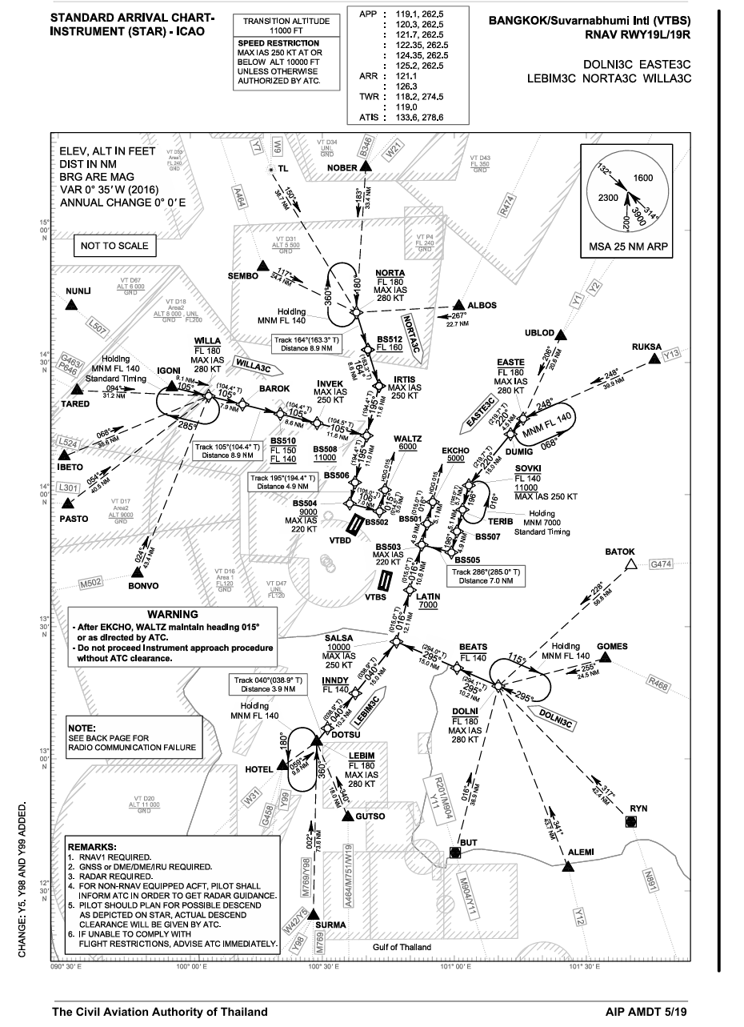

Background
Suvarnabhumi Airport (VTBS) is Thailand’s main international gateway, handling over 800 flights daily, both domestic and international.
As Thailand continues to grow as a tourism and business hub, air traffic congestion has become more common—especially during peak hours.
Weather conditions like storms and heavy rain often lead to route changes, holding patterns, or even delays, making air traffic management more complex.
Fig. 2: BKK Suvarnabhumi Airport (VTBS) Standard Arrival Chart - Instrument (STAR)-LOC

Slide 4
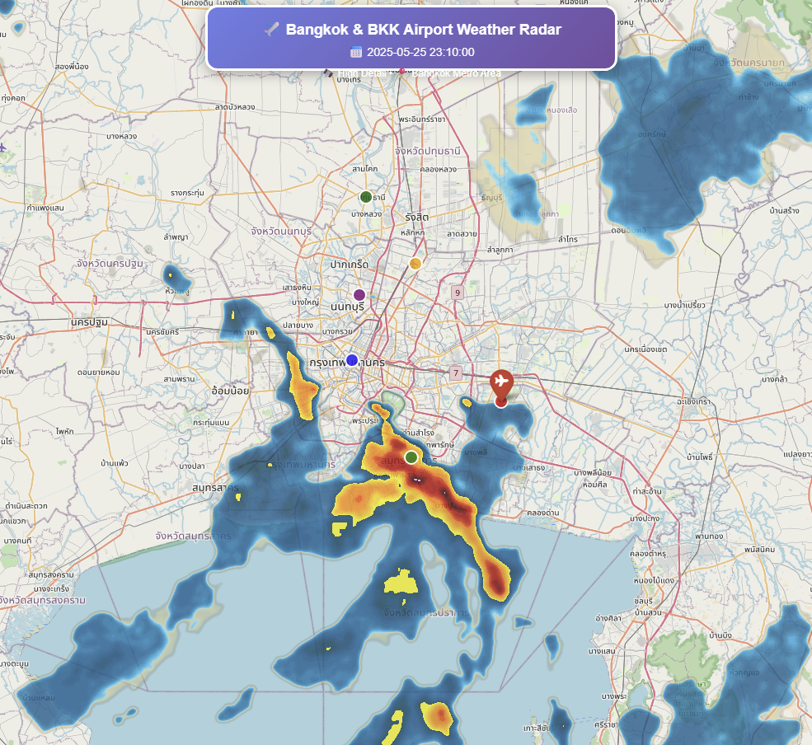

Problem
Bangkok Air Traffic Challenge
Suvarnabhumi Airport (VTBS)
65 million passengers/year
300,000++ flights annually
Weather Problems:
Frequent Thunderstorms (May-October)
Sudden Weather Changes
Maintain airport capacity VS Thunder Lighting Strike
What we learn:
How pilots avoid weather ?
Does wind direction affect decisions ?
When do pilot deviate ?
Fig. 3: Bangkok & BKK Airport Weather Radar (2025-05-25 23:10:00)

Slide 5
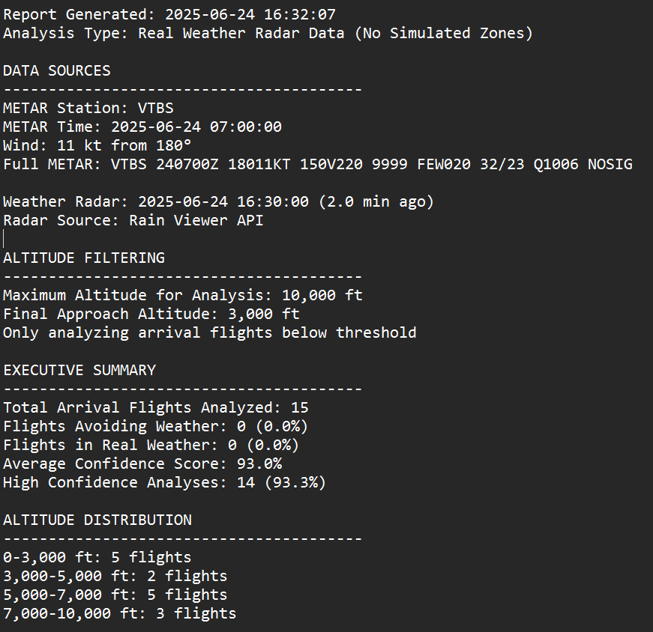
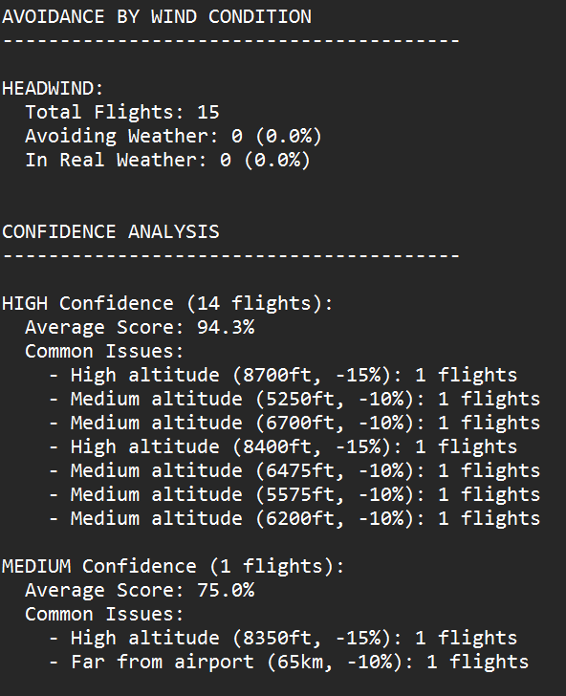
Solution
We created Automated Weather Avoidance Analysis System
What does it do ?:
Track all flight arriving at Suvarnabhumi Airport (VTBS)
Analyzes real weather radar data
Measures avoidance behavior
Correlates with wind conditions
Key Features Combining:
Real-Flight Positions
Actual Weather Data
Wind Conditions
Automated 24/7 analysis
Fig. 4: System Output Report Generated 2025-06-24 16:32:07

Slide 6

Data Sources
✈️ FLIGHT DATA | 🌧️ WEATHER RADAR | 🌬️ WIND DATA
OpenSky Network^{[1]} | RainViewer API^{[2]} | METAR (VTBS)
Position | Precipitation | Speed
Altitude | Intensity (dBZ) | Direction
Heading | Coverage Area | Gusts
Real-Time | Every 5-10 min | Hourly
Coverage Area: 80km radius around Airport (VTBS)
Collection Time: Automated every 10 minutes [1] https://opensky-network.org/
[2] https://www.rainviewer.com/api.html

Slide 7
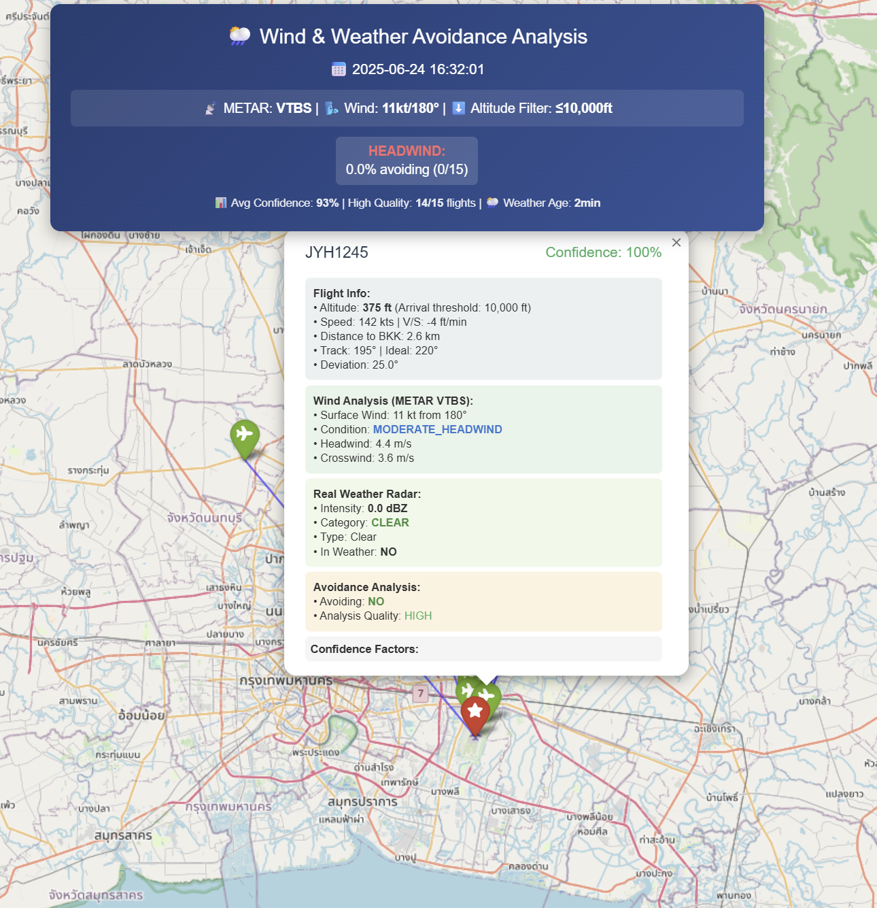

How It Works
Filter Arrival Flights
Altitude ≤ 10,000ft
Within 80Km of VTBS
Descending Aircraft Only
Classify Wind Exposure
Calculate wind relative to approach
Categorize: HEADWIND | TAILWIND | CROSSWIND | CALM
Analyze Weather Position
Extract radar intensity at aircraft location
Measure: Clear | Light | Moderate | Heavy
Detect Avoidance
Compare Actual VS Ideal Heading
If deviation >20° + in Weather = AVOIDING
Assign Confidence Score (0-100%)
Fig. 5: Wind & Weather Avoidance Analysis Interface (2025-06-24 16:30)

Slide 8

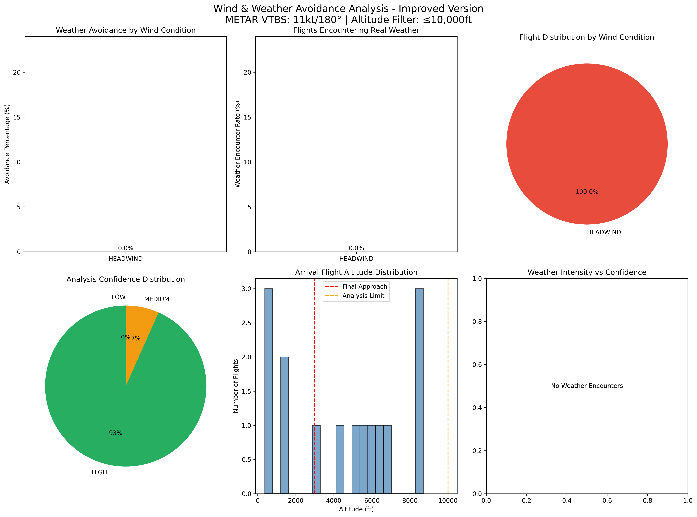

Results
Wind & Weather Avoidance Analysis
METAR VTBS: 11kt/180°| Altitude Filter ≤ 10,000ft
Analysis Results ( June 24, 2025 16:30 )
Total Arrival Flights: | 15
Wind Condition: | HEADWIND
Current Wind: | 11kt/180°
Weather Activity: | MINIMAL
Key Observations:
No weather encounters (clear conditions)
No avoidance behavior detected
High confidence: 93% average
14/15 flights with HIGH confidence
Fig. 6: Analysis Results Dashboard showing weather avoidance patterns

Slide 9
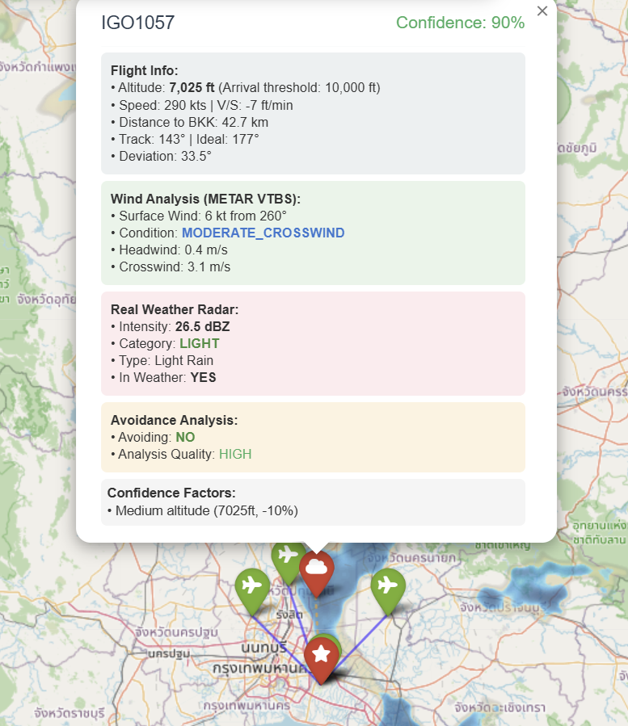

Expected Patterns
Expected During Weather Events:
Wind Type | Expected Behavior
🔄 CROSSWIND | Highest caution
⬅️ HEADWIND | Moderate avoid
➡️ TAILWIND | Least avoidance
⏹️ CALM | Minimal changes
Decision Zones:
> 60 Km: Free Maneuvering – Large deviations possible
40 – 60 Km: Critical Decisions – Most avoidance here
20 – 40Km: Limited Options – Minor adjustment only
< 20 KM: Must Continue – Too close to deviate
Altitude Factor:
>5,000 ft: More Likely to avoid
<3,000 ft: Committed to Landing
Fig. 8: Flight IGO1057 Weather Avoidance Example (2025/06/23 01:40)

Slide 10
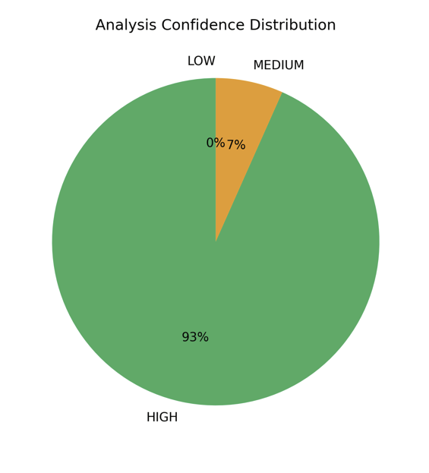

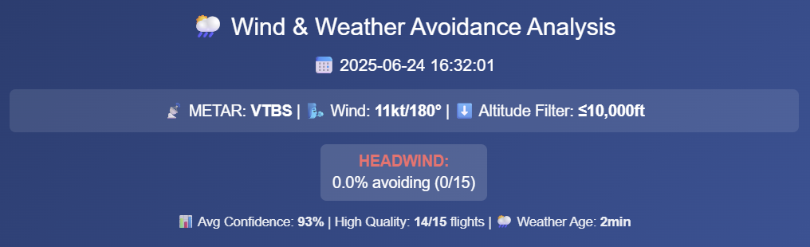

System Capabilities
What Our System Can Detect During Active Weather:
Avoidance patterns by wind type
Critical decision zones (40-60km)
Altitude-dependent behavior
Real-time deviations
Quality Metrics:
Confidence: 93% Average
Quality: 14/15 (93%)
Data Age: 2 minutes
Altitude Distribution:
0 - 3,000 ft : 5 flights
3,000 - 7,000 ft : 7 flights
7,000 - 10,000 ft : 3 flights
Analysis Confidence Distribution
Fig. 7: System Interface showing real-time analysis capabilities

Slide 11

Future Development
Current System:
OpenSky Network Data
Real Weather Data
Surface Wind (METAR)
Basic Pattern Decision
Future Develop:
Estimate the movement of echo data
3D wind Data
In Thailand, 1km² every 10 mins for weather forecast.
Machine Learning model create for greater predictions
Create Historical Pattern database
Continuous Monitoring (24/7)
Applications:
Air Traffic Control – Anticipate deviations
Airlines – Optimize Approach
Research – Safety Studies

Slide 12
Conclusion
What we Achieved:
Automated avoidance analysis for VTBS
Real-Time monitoring system operational
Discovered wind-dependent patterns
Current Status:
System validated during clear conditions
Baseline behavior established
Prepared for weather analysis
Contact:
Krit Ittisomboon
66011042@kmitl.ac.th
GitHub: https://github.com/krithymn/ATMCODE.git
Thank You !

